Slide 1

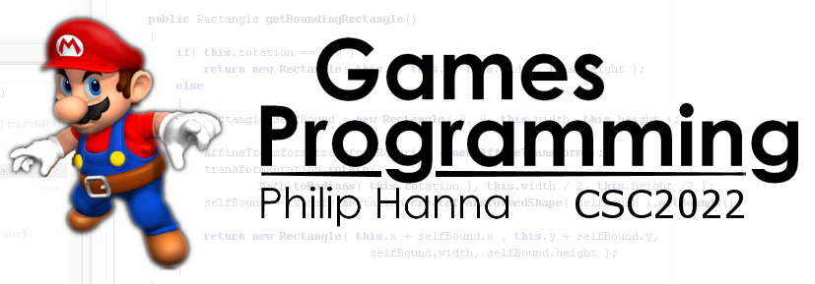
UX Design
Designing with the user’s experience in mind.
Part 1 - Overview

Slide 2
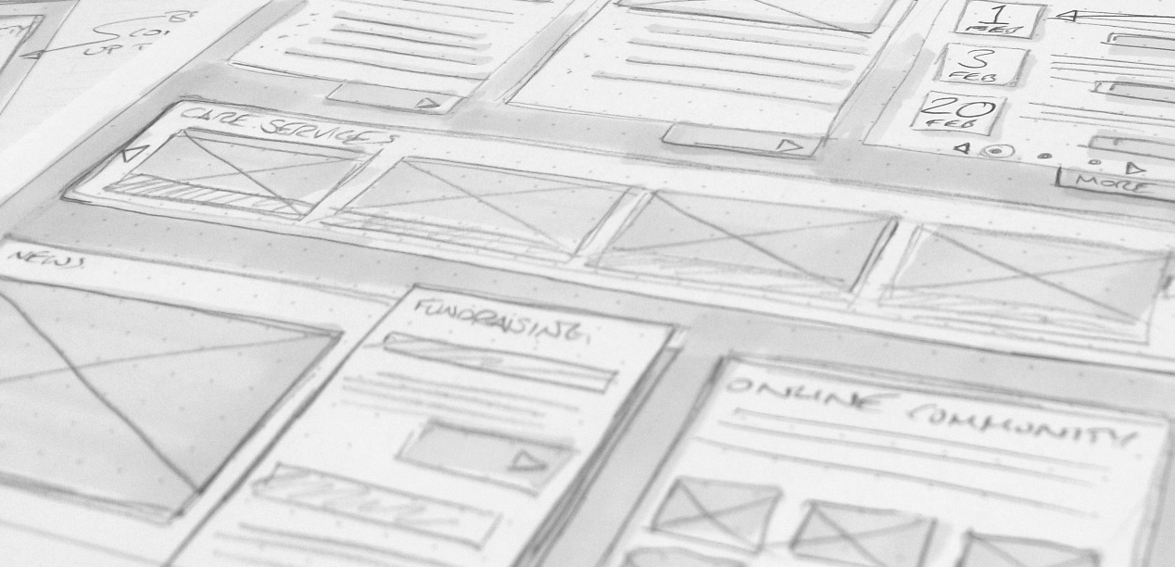


Slide 3

User experience is "a person's perceptions and responses that result from the use or anticipated use of a product, system or service“ (ISO 9241-210)
User experience design (UXD or UED) is the process of enhancing user satisfaction by improving the usability, ease of use, and pleasure provided in the interaction between the user and the product.
Notes:
The ISO definition also encompasses the user’s emotions, beliefs, preferences, etc. that occurs before, during and after use.

Slide 4
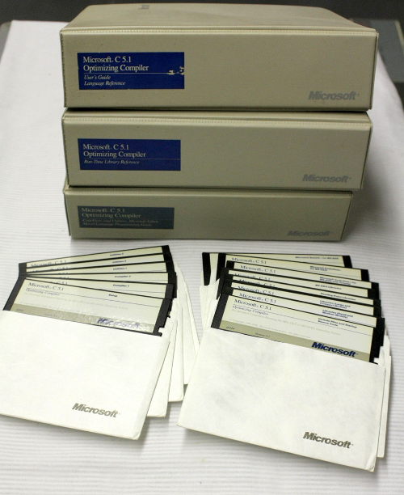

How things have changed…
It was not that long ago that one, or more, manuals needed to be studied before a software package could be effectively used.

Slide 5

Nowadays we expect software to be easy to use without the need for a manual.
But this is actually difficult to do.

Slide 6

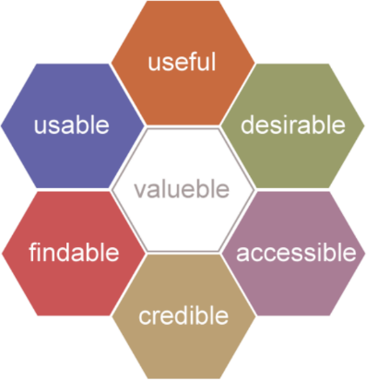
User Experience Honeycomb
Notes:
Peter Morville – User Experience Honeycomb

Slide 7
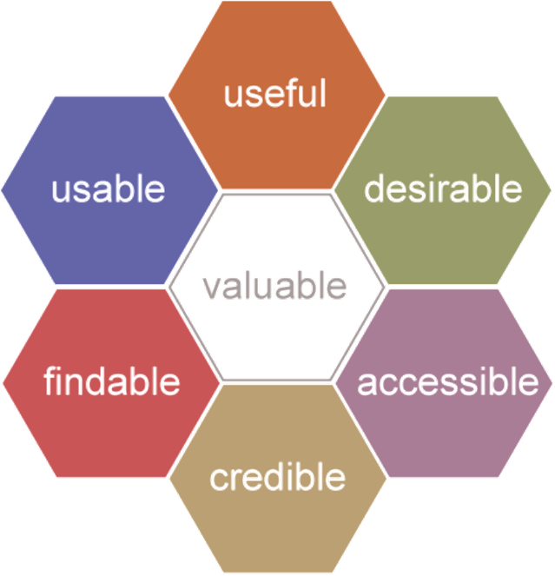
Useful | Fulfils one or more user needs
Usable | Easy for the user to use
Desirable | The user wants to use it and be associated with it (brand, identity, etc.)
Findable | Easily and intuitively navigable by the user
Accessible | Supports users with a disability
Credible | The user should trust and believe in it
Valuable: It should deliver value to the sponsors

Slide 8
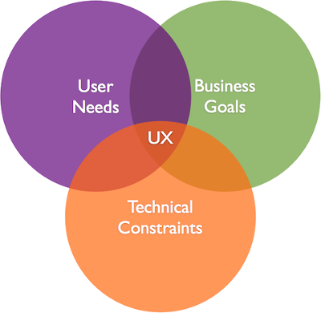
Valuable | It should deliver value to the sponsors
Valuable: It should deliver value to the sponsors

Slide 9
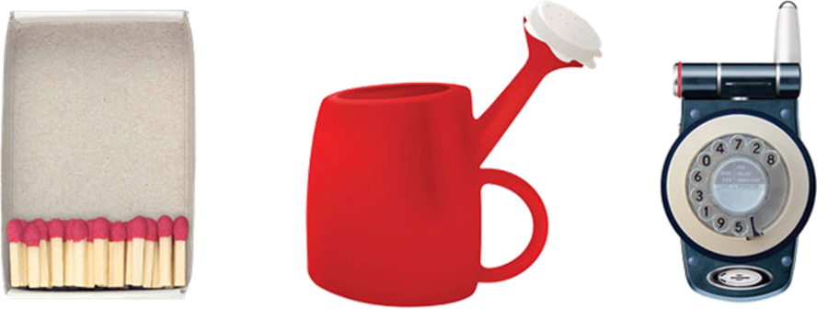
Usability deals with the user-friendliness and efficiency of the user interface.
User experience goes beyond this to capture how the user feels when using the system.
Whilst usability is an important part of the user experience, it is but only one part of the entire user experience.

Slide 10

UX design draws upon many disciplines, including:
psychology
anthropology
sociology
computer science
graphic design
interaction design
cognitive science
industrial design
human factors engineering
However… we’ll mostly just focus on usability

Slide 11

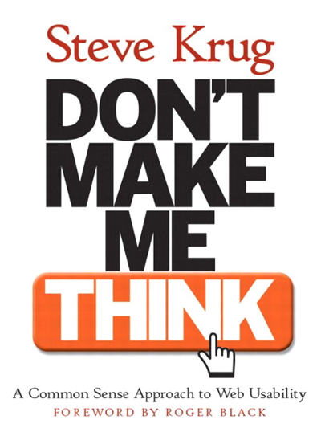
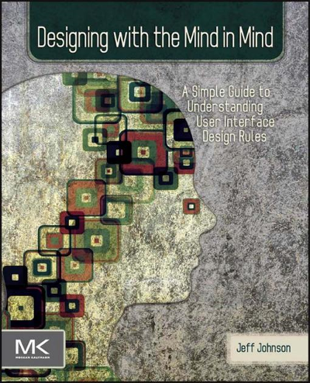
We’ll draw upon a number of good book, including:

Slide 12

Key takeaways:
As users, we expect software to be easy and intuitive to use.
As developers, we must work hard to make the software easy and intuitive.
UX Design is the multi-disciplinary study of how we can accomplish this alongside meeting our business goals.

